Slide 1
MULTIPLAYER SNAKE GAME
Deepak Rajan S (160501039 )
(AI)Artificial Intelligence

Slide 2
ABSTRACT
The purpose of this project is to make the player compete with
each on a multiplayer snake game and make the computer
reflect the moves that the players have used in their previous
games .The model is demonstrated in browser so this game is
developed using the basic SSE technology and record the player
move in a one on one battle with each and tries to use the
previous player’s move. The computer uses the shortest path
algorithm to reach the target with having self destructive moves
and tries to escape from the opponent’s attacking moves by
predicting it before.

Slide 3
SINGLE PLAYER SNAKE GAME:
Game board consist of 2 dimensional space which has walls at the borders.
An User’s Snake is allowed to move around the 2-D space without dashing the wall.
A symbol denoting the food will randomly paced anywhere in the 2-D space.
If the user catch the food, length of the snake body increases
The food will be available only for few seconds.

Slide 4
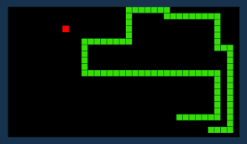
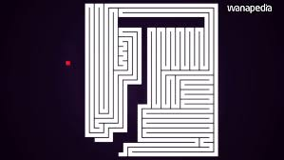
WINNING STAGE FOR SINGLE PLAYER GAME MODE
There is no exact ending point for this mode ,The player can continue playing as long as he did not hit the wall or bites his own snake body.
So the major challenge in this type of game is to decide the correct path to get the food and to continue survival.

Slide 5
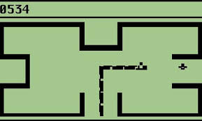
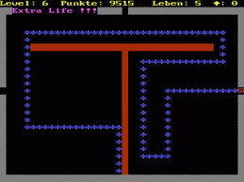
ANOTHER BIG CHALLENEGE
Playing the same snake game with obstacles.
Here the obstacle play the role similar to walls

Slide 6
ROLE OF AI IN SINGLE PLAYERE MODE
To find the optimal path to reach the food Co-ordinate with out hitting the wall or biting the body.
To avoid the failing situations and to increase the survival time .
To find a path that leads the snake to food by avoiding the obstacles.

Slide 7
ALGORITHMS TO FIND SHORTEST PATH
Greedy Path Finder
2. Hamilton Path finder
3. DQN Path Finder
GREEDY
HAMILTON
DQN

Slide 8
MULTIPLAYER SNAKE GAME (INSTRUCTIONS)
In this mode two snake move across the board simultaneously and they fight for the same food.
Like single player mode here also the snake’s body length increases when it gets the food.
Advantage of the multiplayer over single player is that it has game bound i.e when a snake bites the another snake’s head it wins.

Slide 9
CHALLENGES IN MULTIPLAYER SNAKE GAME
To predict the opponents next move
To make decision whether to go for a food or try to attack the opponent.
Reading the user’s move and making use of the previously collected data to make the next best move.

Slide 10
THANK YOU ☺

